Slide 1



Master of Arts in International Affairs (MIA)
Master Info Day 2024

Slide 2
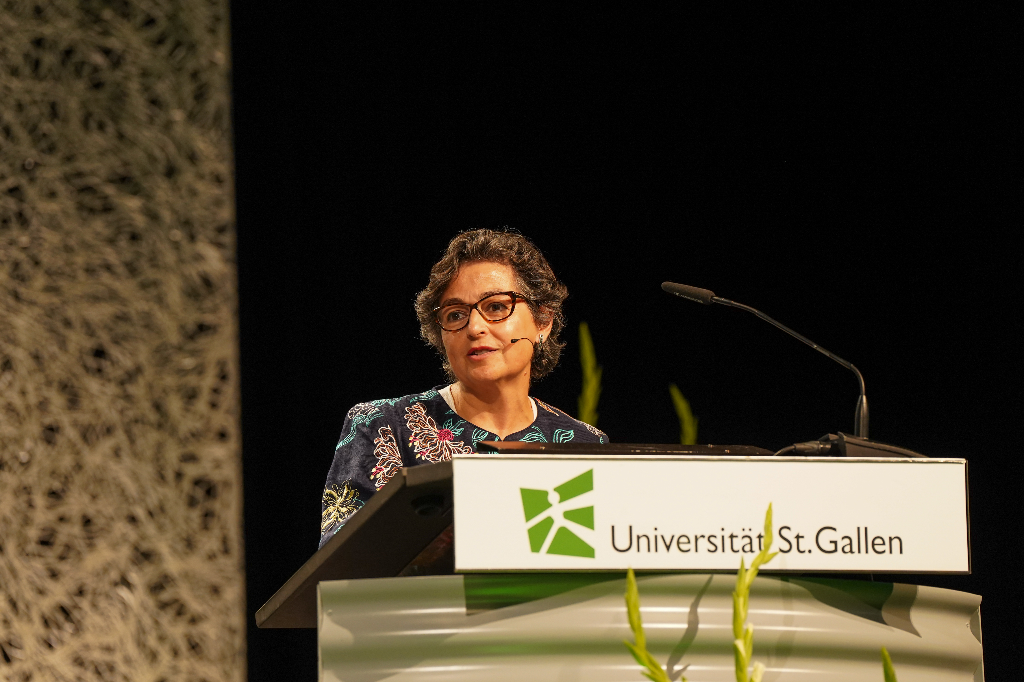

Slide 3


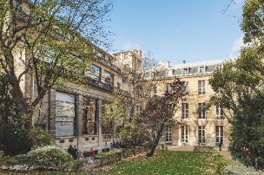

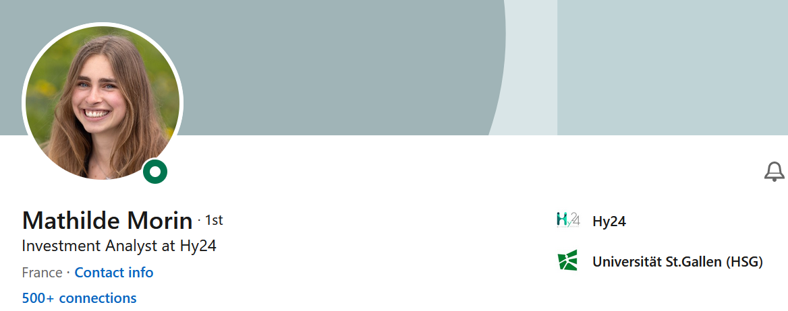


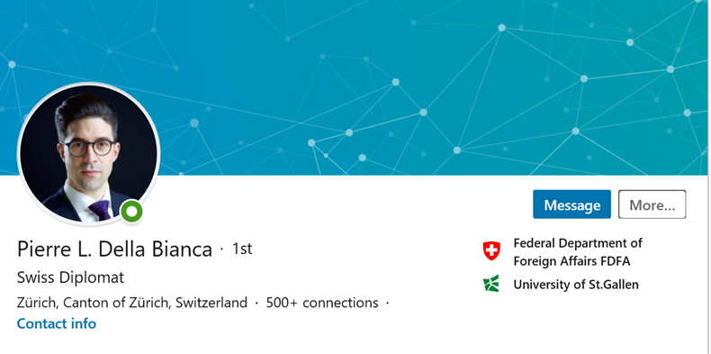
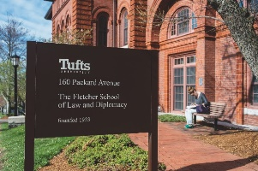

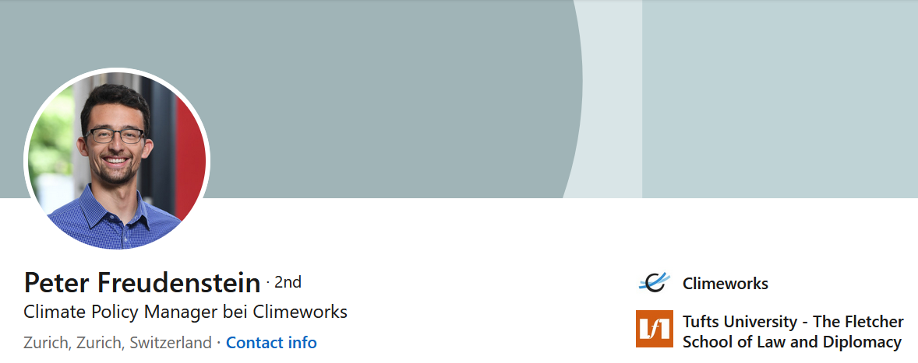

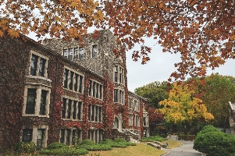

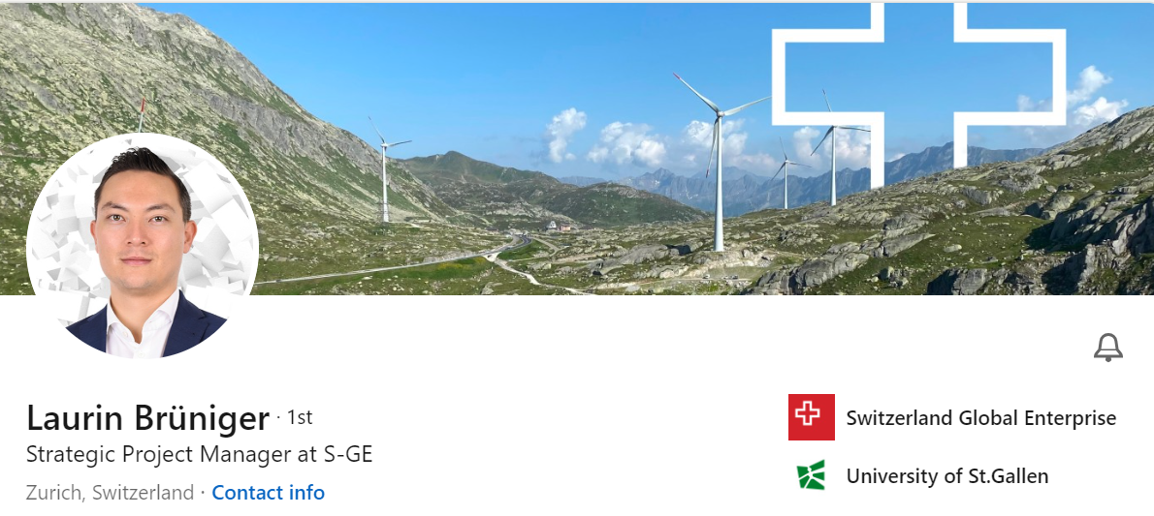

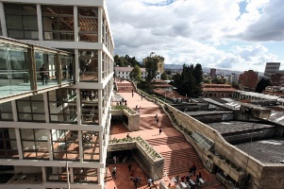


Specialisations
Dual Degrees
Links to practice
A strong and diverse network
4 Disciplines
Political
Science
Economics
Management
Law

Slide 4
Your studies

Slide 5
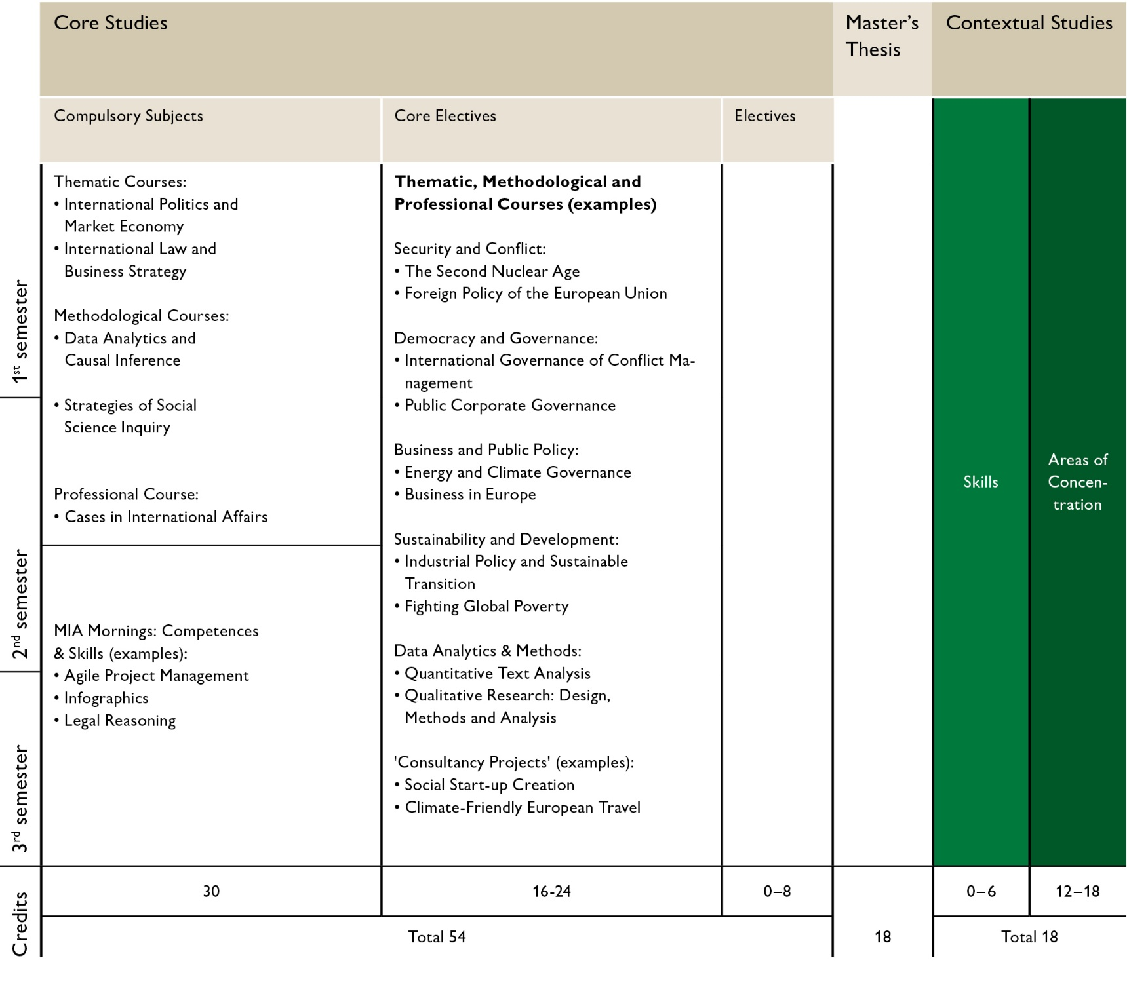





MIA Programme
Architecture
24 ECTS Compulsory Courses
6 ECTS “Cases in IA”
24 ECTS (Core) Electives
18 ECTS Contextual Studies
18 ECTS MA Thesis

Slide 6
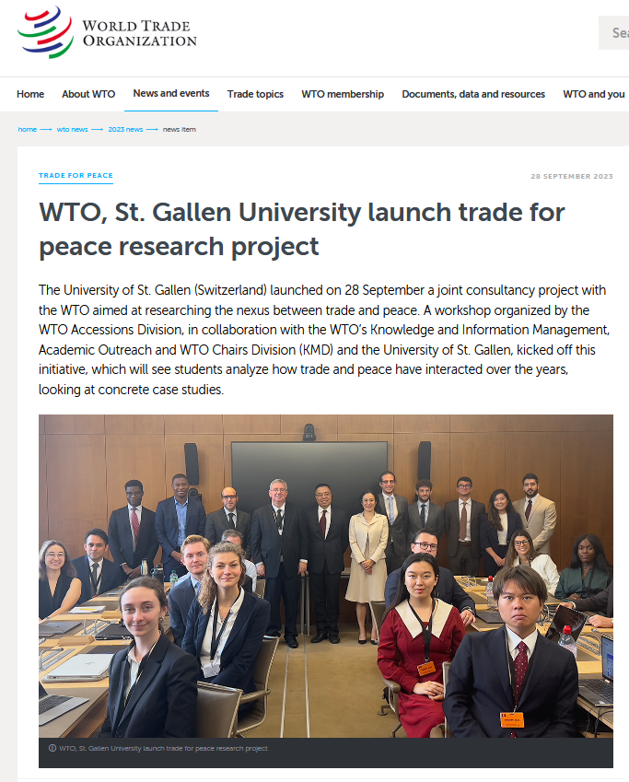





Consultancy Project Courses
Trade for Peace
UN Security Council Reform
Finding Feasible Energy
& Climate Solutions
Knowledge Transfer in Diplomacy
Climate Friendly European Travel

Slide 7
Develop your skills: MIA Morning Workshops
Thematic | Methodological | Professional
Key Concepts in Politics | Quantitative Literacy | Negotiation Techniques
Key Approaches in Politics | Dynamic Documents & Reporting | Communication Skills: Elevator pitch
Economic Principles | Stats Refresher | Agile Project Management
Economic Reasoning | Web Scraping with R | Infographics
Legal Thinking | Data Handling and Coding with Large Language Models | Future Skills: World Bank
Legal Research |  | Mastering complexity
Short 2 hour workshops with preparation, follow-up assignment, and feedback
You take 5 workshops to pass the course “MIA Morning Workshops”

Slide 8
Go international with
International Affairs@HSG

Slide 9
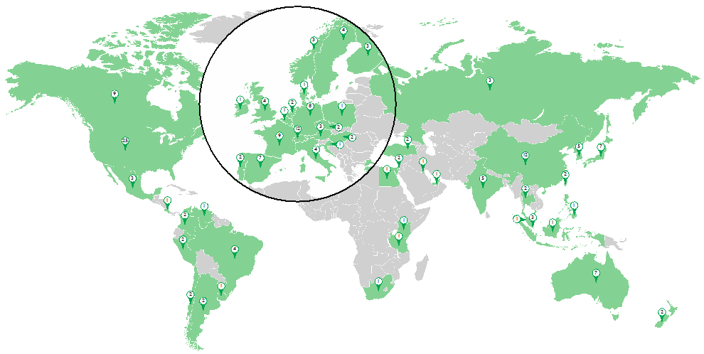

Your exchange options

Slide 10



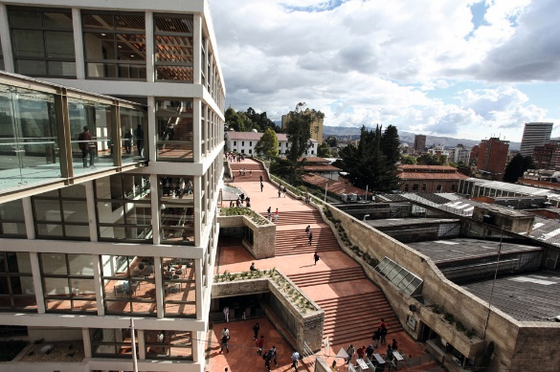

Dual Degrees
Institut d‘Etudes Politiques (Sciences Po)
Paris, France
The Fletcher School of Law and Diplomacy at Tufts University
Medford, USA
Yonsei Graduate School of International Studies
Seoul, Korea
Universidad de los Andes
Bogotá, Colombia

Slide 11


Dual Degree: Best of Two Worlds
Two Master‘s degrees, one application:
Structure
Two degrees
Application process
Tuition fees

Slide 12

MaCS Certificate Programme

Slide 13
What do our alumni do?

Slide 14
Career Prospects

Slide 15
What do MIA Alumni do?

Slide 16
Admissions

Slide 17
Admission
Start: Fall semester
Applications: Window open until 30 April 2024
Requirement: B.A. in International Affairs, Economic or Social Sciences, Legal Studies, or a related major – Proficiency in English
Admission criteria: 60% grades – 30% professional experience / extracurricular commitment – 10% writing sample
2023: ~200 applications, ~70 places

Slide 18
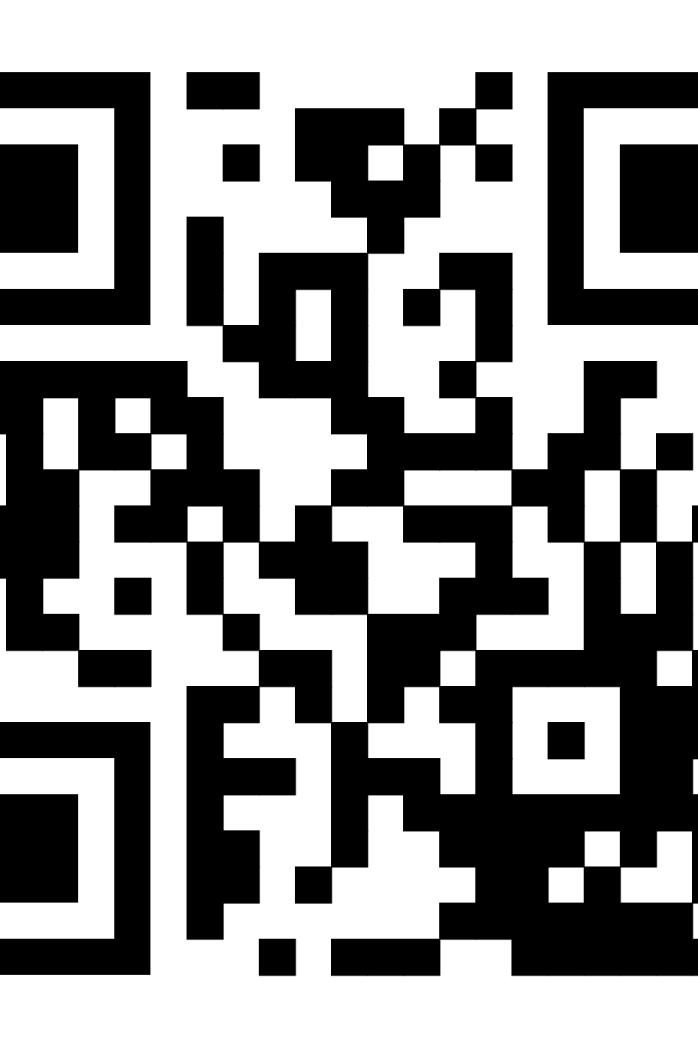

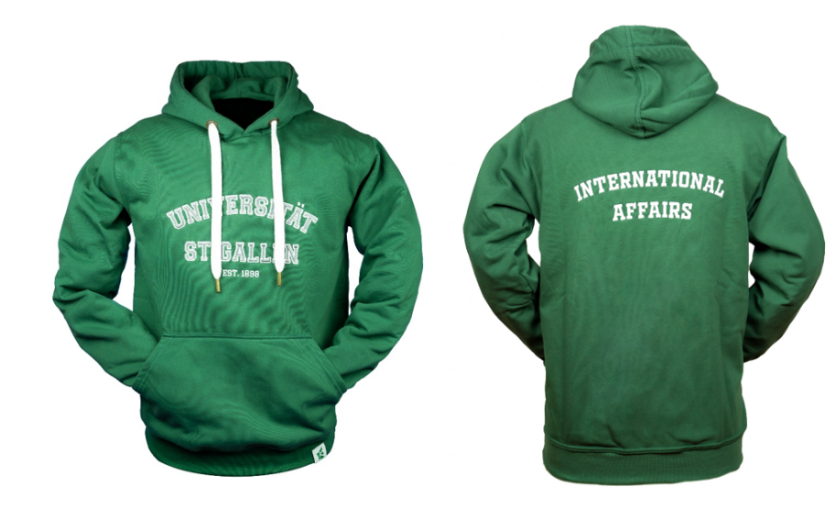
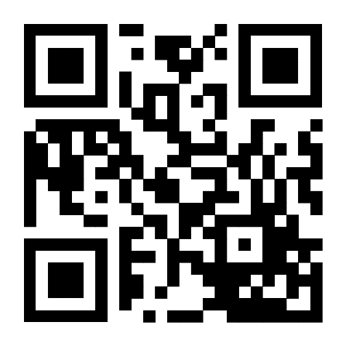
Questions?
Contact us!
mia.unisg.ch
mia@unisg.ch

